Slide 1
Divide & Conquer
Themes
  Reasoning about code (correctness and cost)
  iterative code, loop invariants, and sums
  recursion, induction, and recurrence relations
  Divide and Conquer
Examples
  sorting (insertion sort & merge sort)
  computing powers
  Euclidean algorithm (computing gcds)

Slide 2
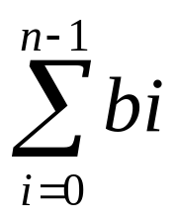
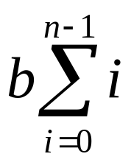
Arithmetic Series
= = b + 2b + 3b + … + (n-1)b
= bn(n-1)/2

Slide 3
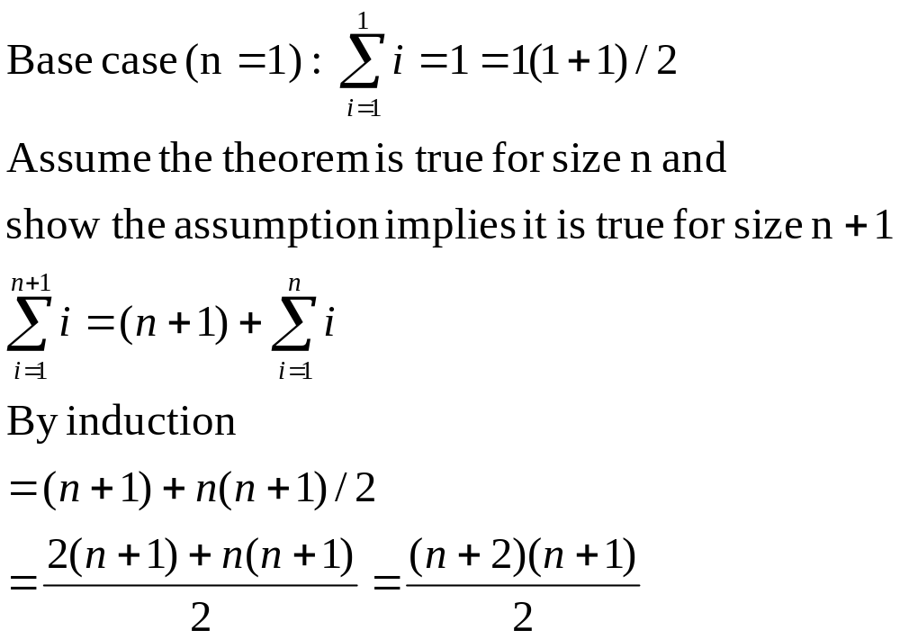
Arithmetic Series (Proof)

Slide 4
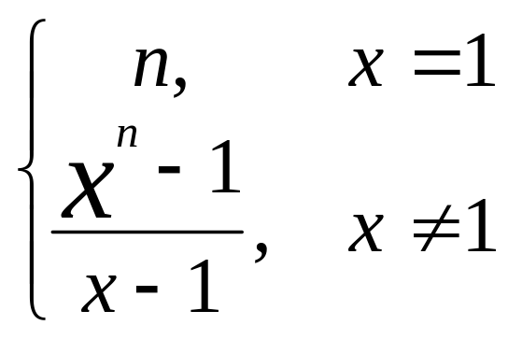
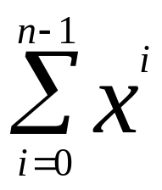
Geometric Series
= 1 + x + x² + … + x^{n-1} =

Slide 5
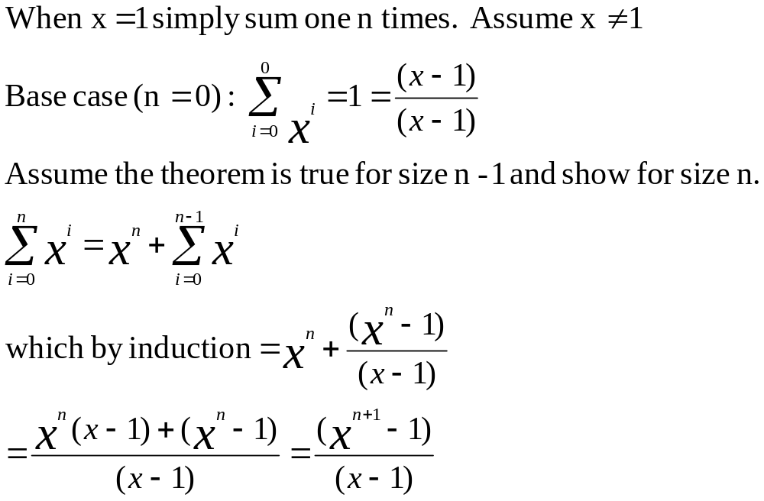
Geometric Series (Proof)

Slide 6
Floor and Ceiling
Let x be a real number
The floor of x, ⎣x⎦, is the largest integer less than or equal to x
  If an integer k satisfies k ≤ x < k+1, k = ⎣x⎦
  E.G. ⎣3.7⎦ = 3, ⎣3⎦ = 3
The ceiling of x, ⎡x⎤, is the smallest integer greater than or equal to x
  If an integer k satisfies k-1 < x ≤ k, k = ⎡x⎤
  E.G. ⎡3.7⎤ = 4, ⎡3⎤ = 3

Slide 7
logarithm
y = log_{b}(x) ⇒ b^{y} = x
Two important cases
  ln(x) = log_{e}(x)
  lg(x) = log₂(x) [frequently occurs in CS]
Properties
  log(cd) = log(c) + log(d)
  log(c^{x}) = xlog(c)
  log_{b}(b^{x}) = x = b^{logb(x)}
  d ln(x)/dx = 1/x

Slide 8
logarithm
2^{k} ≤ x < 2^{k+1} ⇒ k = ⎣lg(x)⎦
  E.G. 16 ≤ 25 < 32 ⇒ 4 ≤ lg(25) < 5
  lg(25) ≈ 4.64
Change of base
  log_{c}(x) = log_{b}(x) / log_{b}(c)
  Proof. y = log_{c}(x) ⇒ c^{y} = x ⇒ ylog_{b}(c) = log_{b}(x) ⇒ y = log_{b}(x) / log_{b}(c)

Slide 9
Insertion Sort
To sort x₀,…,x_{n-1},
  recursively sort x₁,…,x_{n}
  insert x₀ into x₁,…,x_{n-1}
  (see code for details)
Loop invariant
  x₀,…, x_{i-1},t and x_{i+1},…, x_{n-1} sorted
  initialize t = x₀

Slide 10
Insertion Sort (Example)
(7,6,5,4,3,2,1,0)
after recursive call (7,0,1,2,3,4,5,6)
Number of comparisons to sort inputs that are in reverse sorted order (worst case)
C(n) = C(n-1) + (n-1)
C(1) = 0

Slide 11
Merge Sort
To sort x₀,…,x_{n-1},
  recursively sort x₀,…,x_{a-1} and x_{a},…,x_{n-1}, where a = n/2
  merge two sorted lists
Insertion sort is a special case where a=1
  loop invariant for merge similar to insert (depends on implementation)

Slide 12
Merge Sort (Example)
(7,6,5,4,3,2,1,0)
after recursive calls (4,5,6,7) and (0,1,2,3)
Number of comparisons to sort inputs that are in reverse sorted order (worst case)
M(n) = 2M(n/2) + n/2
M(1) = 0
Is this the worst case?

Slide 13
Comparison of Insertion and Merge Sort
Count the number of comparisons for different n=2^{k} (see and run sort.cpp)
M(n)/C(n) → as n increases
C(2n)/C(n) ≈ 4
M(2n)/M(n) → 2 as n increases
n | M(n) | C(n) | M(n)/C(n)
2 | 1 | 1 | 1
4 | 4 | 6 | 0.667
8 | 12 | 28 | 0.429
16 | 32 | 120 | 0.267
32 | 80 | 496 | 0.161
64 | 192 | 2016 | 0.095
128 | 4481 | 8128 | 0.055

Slide 14
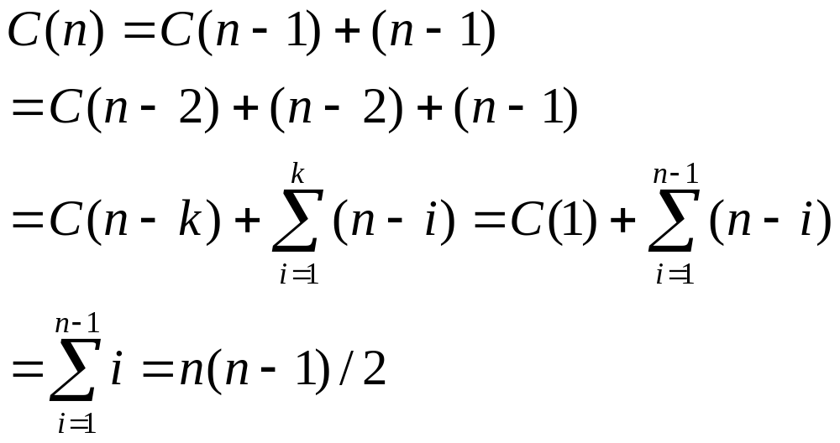
Solve Recurrence for C(n)

Slide 15
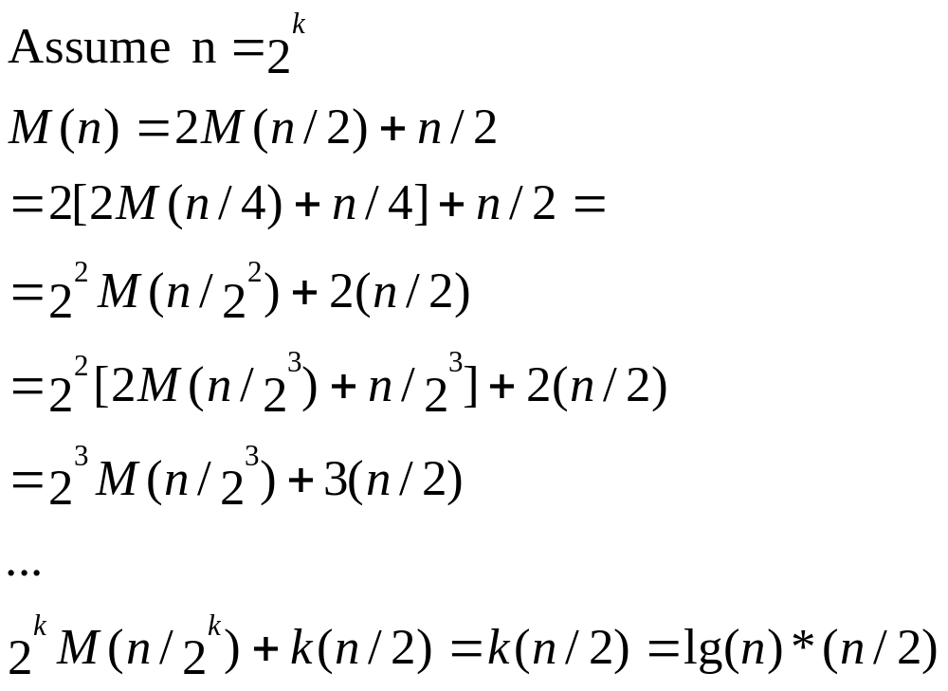
Solve Recurrence for M(n)

Slide 16
Computing Powers
Recursive definition
  a^{n} = a × a^{n-1}, n > 0
  a⁰ = 1
Number of multiplications
  M(n) = M(n-1) + 1, M(0) = 0
  M(n) = n

Slide 17
Binary Powering (Recursive)
Binary powering
  x¹⁶ = (((x²)²)²)², 16 = (10000)₂
  x²³ = (((x²)²x)²x)²x, 23 = (10111)₂
Recursive (right-left)
x^{n} = (x^{⎣n/2⎦})² × x^{(n % 2)}
M(n) ⁼ M(⎣n/2⎦) + [n % 2]

Slide 18
Binary Powering (Iterative)
Loop invariant
  x^{n} = y × z^{N}
  N = n; y = 1; z = x;
  while (N != 0) {
  if (N % 2 == 1)
  y = z*y;
  z = z*z; N = N/2; }
Example
  N y z
  1 x
  11 x x²
  5 x³ x⁴
  2 x⁷ x⁸
  1 x⁷ x¹⁶
  0 x²³ x³²

Slide 19
Binary Powering
Number of multiplications
Let ν(n) = number of 1bits in binary representation of n
M(n) = ⎣lg(n)⎦ + ν(n)

Slide 20
Greatest Common Divisors
g = gcd(a,b) ⇔ g|a and g|b
if e|a and e|b ⇒ e|g
gcd(a,0) = 0
gcd(a,b) = gcd(b,a%b)
  since if g|a and g|b then g|a%b and if g|b and g|a%b then g|a

Slide 21
Euclidean Algorithm (Iterative)
a₀ = a, a₁ = b
a_{i} = q_{i} * a_{i+1}+ a_{i+2} , 0 ≤ a_{i+2} < a_{i+1}
…
a_{n} = q_{n} * a_{n+1}
g = a_{n+1}
http://en.wikipedia.org/wiki/Euclidean_algorithm

Slide 22
Number of Divisions
a_{i} = q_{i} * a_{i+1}+ a_{i+2} , 0 ≤ a_{i+2} < a_{i+1}
a_{i} ≥ (q_{i} + 1)*a_{i+2} ≥ 2a_{i+2}
a_{n} ≥ 2a_{n+1}
a₁ / a₃ × a₂ / a₄ × … × a_{n-1} / a_{n-2} × a_{n} / a_{n+1} ≥ 2^{n}
n ≤ lg(a₁a₂ /g²)
if a,b ≤ N, # of divisions ≤ 2lg(N)

